Slide 1

UNIT 5
FILE SYSTEM
FILE ALLOCATION METHODS

Slide 2
Allocation Methods
Three major methods of allocating disk space are in wide use:
contiguous,
linked, and
indexed.
Contiguous Allocation
Contiguous allocation requires that each file occupy a set of contiguous blocks on the disk.
Disk addresses define a linear ordering on the disk.
Contiguous allocation of a file is defined by the disk address and length (in block units) of the first block.
The directory entry for each file indicates the address of the starting block and the length of the area allocated for this file.
Both sequential and direct access can be supported by contiguous allocation.
Disadvantage
Finding space for a new file. Dynamic storage-allocation problem, which involves how to satisfy a request of size n from a list of free holes.
First fit and best fit are the most common strategies used to select a free hole from the set of available holes.
All these algorithms suffer from the problem of external fragmentation.
Compaction – Move all file from disk another to free it up and move back all the files by contiguously.
Compaction offline (downtime) or online.

Slide 3
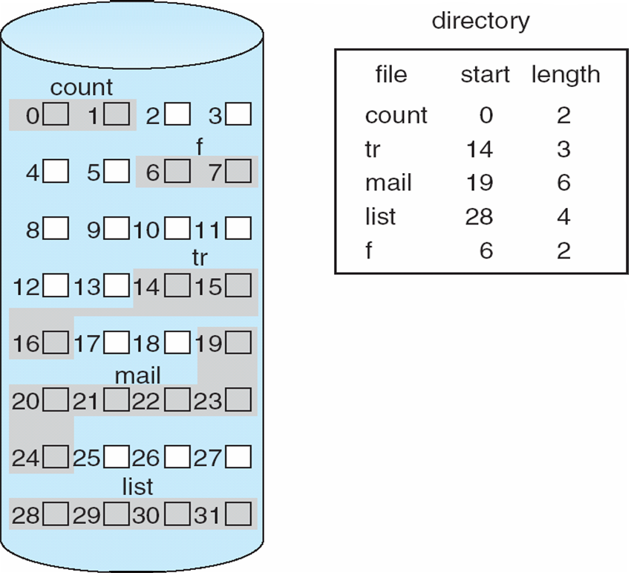
Allocation Methods - Contiguous Allocation
Contiguous allocation

Slide 4
Allocation Methods –Linked Allocation
Each file is a linked list of disk blocks;
The directory contains a pointer to the first and last blocks of the file.
Each block contains a pointer to the next block.
These pointers are not made available to the user. Thus, if each block is 512 bytes in size, and a disk address (the pointer) requires 4 bytes, then the user sees blocks of 508 bytes.
There is no external fragmentation with linked allocation, so no compaction needed.
Disadvantage
The major problem is that it can be used effectively only for sequential-access files.
To find the ith block of a file, we must start at the beginning of that file and follow the pointers until we get to the ith block.
Each access to a pointer requires a disk read, and some require a disk seek.
Consequently, it is inefficient to support a direct-access capability for linked-allocation files.

Slide 5
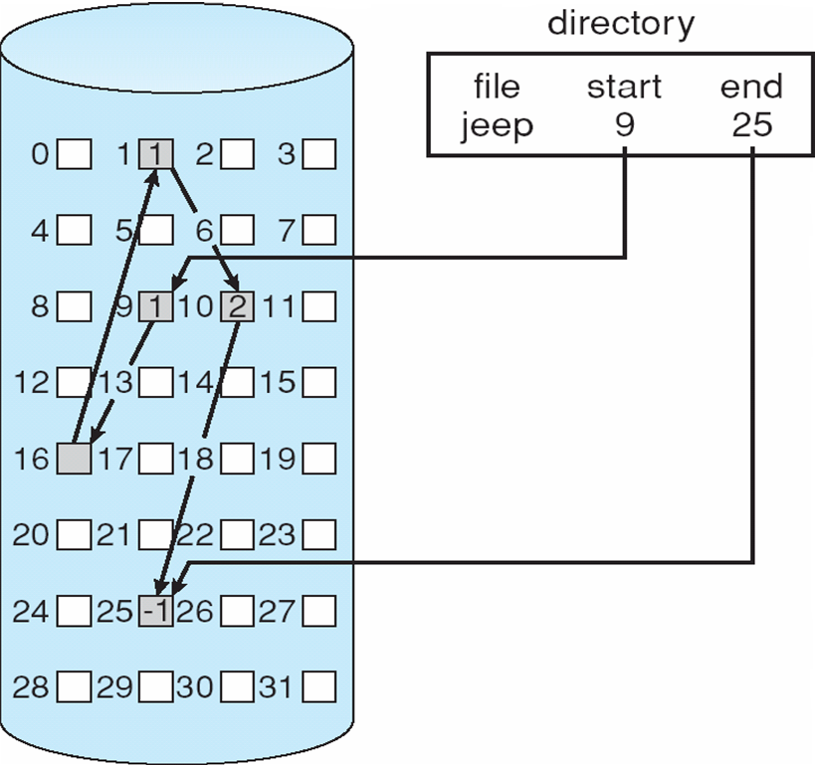
Allocation Methods –Linked Allocation

Slide 6
Allocation Methods –Linked Allocation
Another disadvantage is the space required for the pointers. If a pointer requires 4 bytes out of a 512-byte block, then 0.78 percent of the disk is being used for pointers, rather than for information.
The usual solution to this problem is to collect blocks into multiples, called clusters, and to allocate clusters rather than blocks.
Improve efficiency by clustering blocks into groups but increases internal fragmentation
Reliability can be a problem – Pointers are all linked and one pointer lost or damaged.
Locating a block can take many I/Os and disk seeks

Slide 7
Allocation Methods – Indexed Allocation
Each file has its own index block, which is an array of disk-block addresses.
The directory contains the address of the index block.
To find and read the ith block, we use the pointer in the ith index-block entry.
Indexed allocation supports direct access, without suffering from external fragmentation, because any free block on the disk can satisfy a request for more space.
Indexed allocation does suffer from wasted space, however.
The pointer overhead of the index block is generally greater than the pointer overhead of linked allocation.
Consider a common case in which we have a file of only one or two blocks. With linked allocation, we lose the space of only one pointer per block.
With indexed allocation, an entire index block must be allocated, even if only one or two pointers will be non-null.

Slide 8
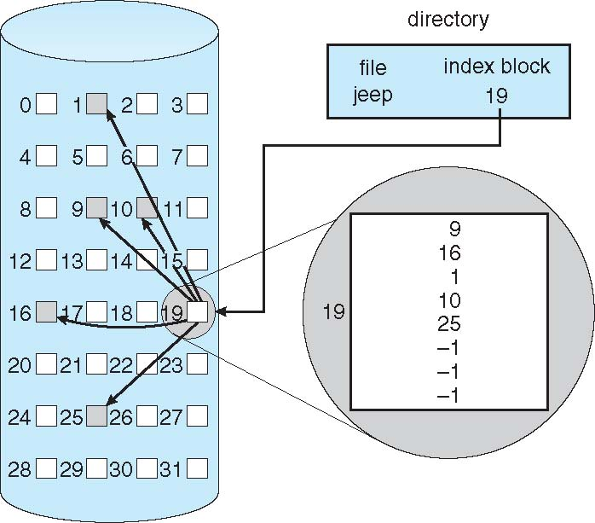
Allocation Methods – Indexed Allocation

Slide 9
Allocation Methods – Indexed Allocation
One solution is to keep index block small, but If the index block is too small, however, it will not be able to hold enough pointers for a large file. This problem can be addressed by
Linked scheme
An index block is normally one disk block. To allow for large files, we can link together several index blocks.
Multilevel index
A variant of linked representation uses a first-level index block to point to a set of second-level index blocks, which in turn point to the file blocks.
Combined scheme
Have 15 pointers of the index block in the file’s inode.
The first 12 of these pointers point to direct blocks; that is, they contain addresses of blocks that contain data of the file. Thus, the data for small files (of no more than 12 blocks) do not need a separate index block.
The next three pointers point to indirect blocks.
The first points to a single indirect block, which is an index block containing not data but the addresses of blocks that do contain data.
The second points to a double indirect block, which contains the address of a block that contains the addresses of blocks that contain pointers to the actual data blocks. The last pointer contains the address of a triple indirect block.

Slide 10
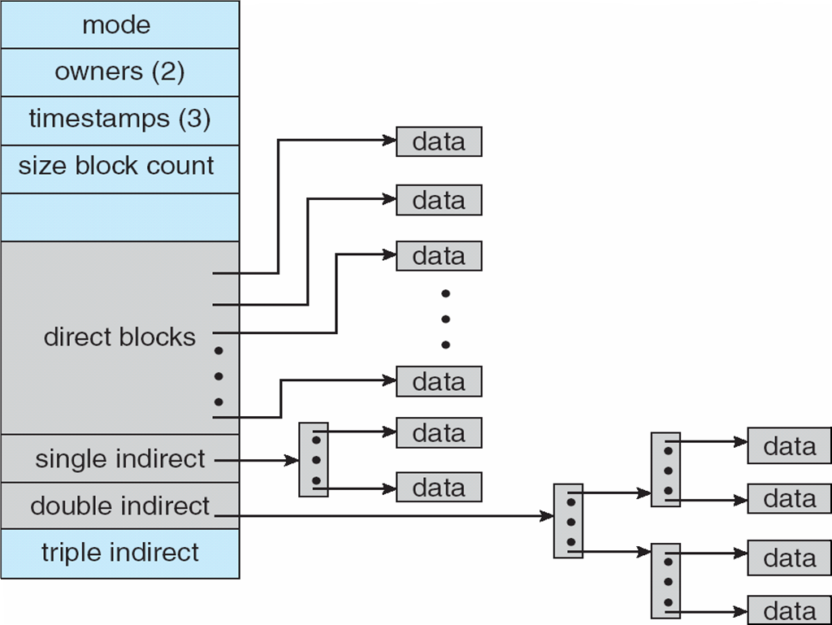
Allocation Methods – Indexed Allocation

Slide 11
THANK YOU

